Slide 1
PROPOSALS
CONTENT
FACEBOOK/ WEBSITES

Slide 2
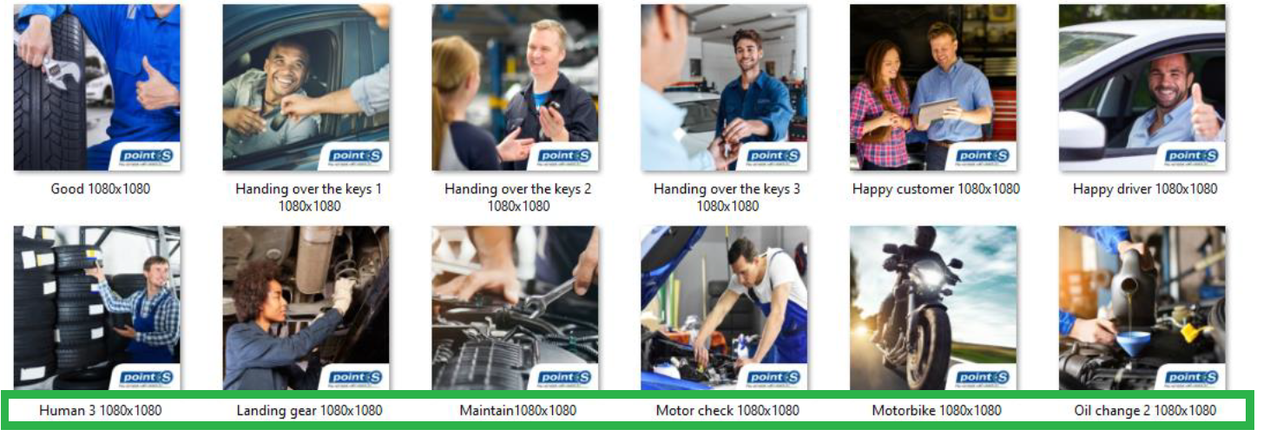
How to make the posts?
3 pillars for efficient communication
1. CONTENT:
Use your own content (about brand, network, services, products)
OR/AND
Use the posts suggestions we prepared for you (see all the next slides). We've prepared a selection of ideas for publications on various themes, so all you have to do is translate them and adapt them to your market, if necessary.
2. VISUAL:
It is more efficient to add a visual to your content to make your post more attractive!
Use your visuals with on each one, bottom right corner, No stress with Point S rounded insert.
OR
Use one of the visual of the library (visuals sent on the link) → ready to post: a library with more than 50 pictures with layout ready to use + a legend to help you use it according to the theme you want
3. LOGO
Each post should contain our network logo

Slide 3
Summary
THEME
Point S
General topic
Premium tyres
Summer tyres
Winter tyres
4 Seasons tyres
Point S Tyres range
Point S Summer
Point S Winter
Point S 4 seasons
Private label
&

Slide 4
Publication ideas for all topics

Slide 5
Wheel alignment
Don't overlook wheel alignment!
When should you align your wheels?
- After any accident, even a minor one.
- If your car pulls to one side.
- If your tyres wear out unusually fast.
- When fitting new tyres on a used car.
Regular alignment saves fuel and keeps your tyres in good shape, making your car safer and more efficient. Check alignment once a year.
Visit your Point S center to get more information!
#WheelAlignment #CarMaintenance

Slide 6
Wheel alignment
When to go to your garage for a wheel alignment test?
- When you maintain a linear trajectory, your steering wheel is not centered.
- When you notice that the vehicle is moving left or right at a constant speed or while braking or accelerating.
- When tyre wear increases from one end to the other.
Regular maintenance is required to keep the vehicle in good alignment. This preserves the good behavior of your vehicle so also prevents premature wear of the tyres but also the change of other expensive motor parts.

Slide 7
Emission Control
Why Emission Control is Essential?
A poorly tuned engine consumes more fuel, pollutes more, and wears out faster. And emission control tuning is not expensive. It helps you smoothly pass the technical inspection by adjusting elements such as ignition, fuel mixture, or injection pump, depending on your car's engine.
Visit your Point S center to get more information !

Slide 8
Importance of your tyres
Point S helping you know the importance of your tyres !
1. The only Point of Contact
Your tyres are the only link between your car and the road. They ensure your stability, direction, and braking. Choosing the right tyres means choosing safety.
2. Bearing Immense Pressures
Your tyres bear the entire weight of your vehicle, regardless of its size.
3. Resisting Moving Forces
When you accelerate or brake brusquely, your tyres must withstand the forces exerted on them.
4. Absorbing Shocks
On uneven roads, your tyres are the first to absorb shocks.
So, take care of them and choose them wisely for a confident and responsible drive.
Your Point S center helps you to find out the best product for your car

Slide 9
Wiper blades
How do you know if you need to change your wiper blades?
- when they make noise
- if they return jerkily
- if they leave marks on the windshield after their passage.
Generally, wiper blades need to be changed once a year. This one-year period depends on the frequency of use and the weather conditions. In summer, heat and sun damage rubber: in winter, cold temperatures can cause cracks.
Don’t hesitate to ask you Point S point of sale for more information!

Slide 10
Car's Performance
Preserving Your Car's Performance and Durability Through Emission Control !
If your vehicle is over 4 years old and weighs less than 3.5 tons, the technical inspection and emission control test are crucial steps to be performed every two years at authorized centers. These examinations ensure both the environmental and mechanical compliance of your vehicle.
Please adapt the post to your country

Slide 11
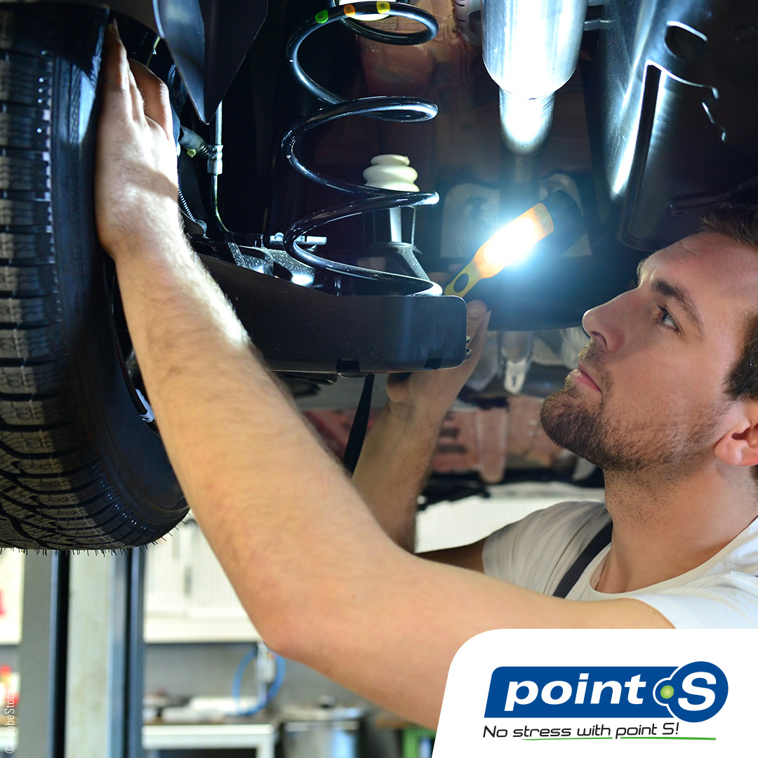
Maintenance of your vehicle
When to do the maintenance of your vehicle?
Regular checks are very important for your car. If it is done on time, it guarantees the proper functioning of the vehicle.
Car maintenance must be done every 10,000 to 30,000 kilometers. For a petrol car, it must be made more frequently than for diesel, approximately every 10,000 to 15,000 kilometers.
Don’t hesitate to ask you Point S store for more information!

Slide 12
Fuel consumption
How to reduce your fuel consumption?
- Inflate your tyres
Under-inflated tyres increase rolling resistance, resulting in excessive fuel consumption.
- Anticipate the road
The greatest fuel consumption takes place during acceleration, in urban areas the phase of deceleration and acceleration is greatly multiplied, leaving the necessary distance between your car and the one in front of you, You will reduce the speed variations, which will be more economical.
- Reduce vehicle load
The heavier your vehicle is, the more fuel it consumes. Overloading can increase your fuel consumption by 15%.
- Does not use air conditioning
The use of air conditioning increases fuel consumption.
Don't hesitate to visit your Point S center for more information!

Slide 13
Air conditioning
Your air conditioning
Maintain your air conditioning throughout the year. The first thing to do to save your air conditioning and keep it performing well over the years is to run it regularly regardless of the season.
It is recommended that you use your air conditioning for about 10 minutes every week to keep the system running. There are several additional things you can do to prolong the life of your air conditioning.
As always, turn off your air conditioning for several minutes before switching off the engine. We recommend that you change the filter and clean the refrigerant circuit every year and recharge the refrigerant every 2 years.
The air conditioning system is complex, so we strongly recommend you consult a Point S expert!

Slide 14
Fuel consumption
How can I reduce my fuel consumption?
Have you heard about the fuel price increase? You probably have. Point S helps you by providing you with several elements to reduce your fuel bill: the impact of your tyres, the traffic on the road, the weather, the speed, the traffic conditions, your driving style... So many things to take into consideration to control and manage your fuel consumption. Don't hesitate to contact your Point S centre for advice on the tyres best suited to your vehicle.

Slide 15
The 8 essential accessories
The 8 essential accessories to keep in your car
A complete first-aid kit
A flashlight
Water bottle and non-perishable food
A blanket and hot clothes
A scraper
Antifreeze and windshield washer
Boosting cables
Sand
With these essential accessories, you are now ready to hit the road in all circumstances!

Slide 16
Brake pads
How do I know if need to change my brakes pads?
Most recent vehicles are equipped with a brake pad wear warning system. A light will illuminate on the dashboard if applicable.
In the case of a worn brake pad, the most common symptom is braking noise.
Other symptoms are also common, such as vibration from braking, shaking or a very soft brake pedal.
A worn brake pad will damage the brake disc.
But it also causes brake failure and increases the risk of accidents.
Don’t hesitate to ask you Point S point of sale for more information!

Slide 17
Good to know!
Good to know!
A speed of 70 km/h on a wet road can increase the braking distance by 42%!
A speed of 90 km/h on dry roads can increase the braking distance by 19.3%!

Slide 18
What is a flexfuel vehicle?
What is a flexfuel vehicle?
Flexfuel technology allows you to run on either petrol or E85 superethanol, or a mixture of the two. A flexfuel vehicle may also be called a flexfuel vehicle or a flexfuel vehicle (FFV).
The flexfuel solution considerably improves vehicle performance, with a quieter engine and, above all, a real reduction in fuel consumption. For drivers who are concerned about the environment, their wallets or both! The flexfuel solution is your solution.
For more information about installing this technology, recommend you consult a Point S expert !

Slide 19
Don't compromise on your driving safety!
Don't compromise on your driving safety!
When it comes to tyres, don't underestimate the importance of choice!
- Premium tyres are much more than just black rubber. They provide safety, reliability, and superior performance. Think about rolling resistance, grip on dry/wet roads, noise, braking, road holding, comfort, and durability. Investing in road safety comes at a cost, but it's worth it.
- Quality tyres offer an excellent value for money. A solid option without the premium tyre costs.
- Budget tyres are economical but less technologically advanced. Perfect for occasional use without emptying your wallet.
Choose carefully because tyres make a difference on the road! #Tyrespremium #QualityTyres #BudgetTyres

Slide 20
Road safety (Option 1)
Road safety
1. Adopt the right driving position: For optimal control of your vehicle, make sure you have a comfortable driving position that allows natural access to the pedals and steering wheel. Adjusting your mirrors is also crucial for maximum responsiveness.
2. Regularly maintain your vehicle: Small imperfections can lead to significant problems. Ensure your vehicle remains in good condition by conducting regular checks.
3. Respect safety distances: Maintain a minimum of 3 seconds of distance from the vehicle in front of you to prevent collisions in emergencies.
4. Be careful at night and in rainy weather: Nighttime driving presents additional challenges in terms of visibility and fatigue. Take breaks if necessary. And stay vigilant in rainy weather, as your vehicle may lose grip.
5. Know your blind spots: Blind spots are hazardous areas that every driver must monitor. Be especially vigilant when changing lanes or direction.
Road safety begins with responsible driving habits. Share these tips with your friends to contribute to safer roads!
#SafeDriving #RoadSafety

Slide 21
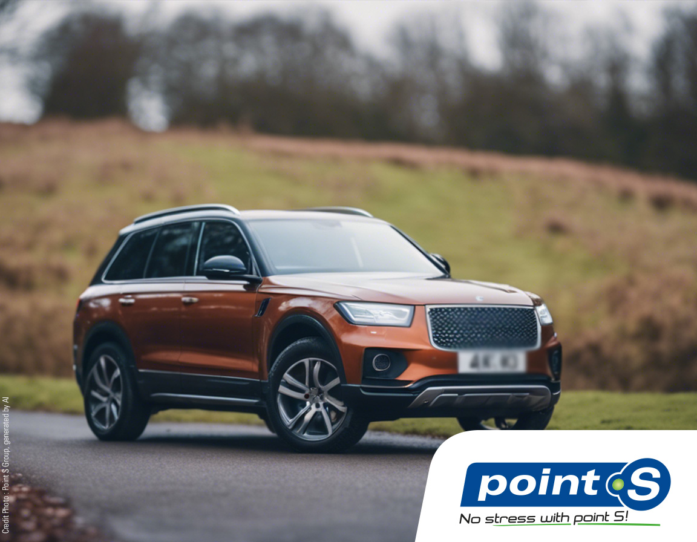
Road safety
(Option 2 : one post per day for 5 days)
Day 1 : Road safety
Adopt the right driving position: For optimal control of your vehicle, make sure you have a comfortable driving position that allows natural access to the pedals and steering wheel. Adjusting your mirrors is also crucial for maximum responsiveness.
Road safety begins with responsible driving habits. Share these tips with your friends to contribute to safer roads!
#SafeDriving #RoadSafety

Slide 22
Road safety
(Option 2 : one post per day for 5 days)
Day 2 : Road safety
Regularly maintain your vehicle: Small imperfections can lead to significant problems. Ensure your vehicle remains in good condition by conducting regular checks.
Road safety begins with responsible driving habits. Share these tips with your friends to contribute to safer roads! #SafeDriving #RoadSafety

Slide 23
Road safety
(Option 2 : one post per day for 5 days)
Day 3 : Road safety
Respect safety distances: Maintain a minimum of 3 seconds of distance from the vehicle in front of you to prevent collisions in emergencies.
Road safety begins with responsible driving habits. Share these tips with your friends to contribute to safer roads!
#SafeDriving #RoadSafety

Slide 24
Road safety
(Option 2 : one post per day for 5 days)
Day 4 : Road safety
Be careful at night and in rainy weather: Nighttime driving presents additional challenges in terms of visibility and fatigue. Take breaks if necessary. And stay vigilant in rainy weather, as your vehicle may lose grip.
Road safety begins with responsible driving habits. Share these tips with your friends to contribute to safer roads!
#SafeDriving #RoadSafety

Slide 25
Road safety
(Option 2 : one post per day for 5 days)
Day 5 : Road safety
Know your blind spots: Blind spots are hazardous areas that every driver must monitor. Be especially vigilant when changing lanes or direction.
Road safety begins with responsible driving habits. Share these tips with your friends to contribute to safer roads!
#SafeDriving #RoadSafety

Slide 26
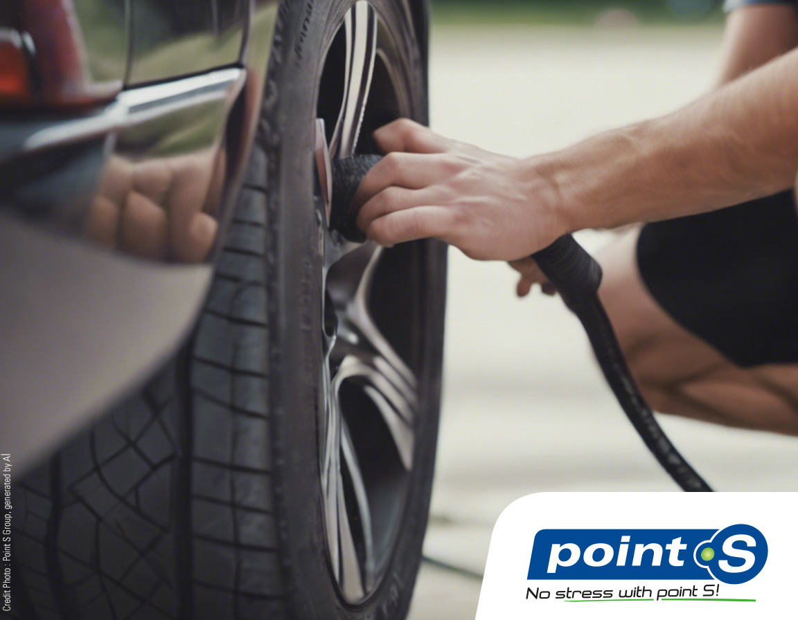
Road safety
Road safety
An under-inflated tyre loses its precision and might increase aquaplaning risks.
Breaking distance is increased: a under inflated tyre can lead to a braking distance of up to 10 meters more than the same tyre properly inflated.
Decrease in longevity, a tyre under inflated loses about 20% less kilometer's performances.
Increased fuel consumption.
Risk of tyre explosion.
Don’t hesitate to ask your Point S point of sale for more information!

Slide 27
Publication ideas for PREMIUM tyres

Slide 28
Point S has tested them for you!
Point S has tested them for you!
Point S has undertaken a unique test on the market. A completely independent test (carried out by TÜV SUD Product Service), assessing the performances of PREMIUM tyres in terms of safety and longevity.
How relevant is this test?
A car weighs on average 1400 kg, the equivalent of 350 kg per tyre
A car rests on a surface equivalent to a sheet of A4 paper
The contact surface on the ground between a tyre and the road is approximately 185cm², or the surface of a hand
Given the minimal contact surface and the significant stresses, the tyre must offer maximum performances.
Test requested by Point S from TÜV SÜD Product Service (independent laboratory, recognized throughout Europe): 225/40 R18 92Y. Brands tested: 5 PREMIUM vs. 3 second line vs. 3 budget. October 2023, VW Golf VIII GTD, report number 713311093-PR
#PointS #PremiumTyres #RoadSafety

Slide 29
Point S has tested them for you!
Point S has tested them for you!
Have you ever compared PREMIUM tyres with others? Point S network did! Point S launched a unique test on the market, a totally independent study highlighting the performances of PREMIUM tyres in terms of safety and longevity.
The test was conducted by the independent laboratory TÜV SÜD Product Service, recognized internationally. It compares on a key tyre dimensio brands against one another: 5 PREMIUM vs. 3 second line vs. 3 budget. The results are indisputable!
The performances of PREMIUM tyres are clearly highlighted in this test, demonstrating the crucial importance of investing in PREMIUM tyres for your safety and that of others on the road.
Don't compromise your safety. Choose PREMIUM tyres today!
Test requested by Point S from TÜV SÜD Product Service (independent laboratory, recognized throughout Europe): 225/40 R18 92Y. Brands tested: 5 PREMIUM vs. 3 second line vs. 3 budget. October 2023, VW Golf VIII GTD, report number 713311093-PR
Visit a Point S centre for more information #PointS #PremiumTyres #RoadSafety

Slide 30
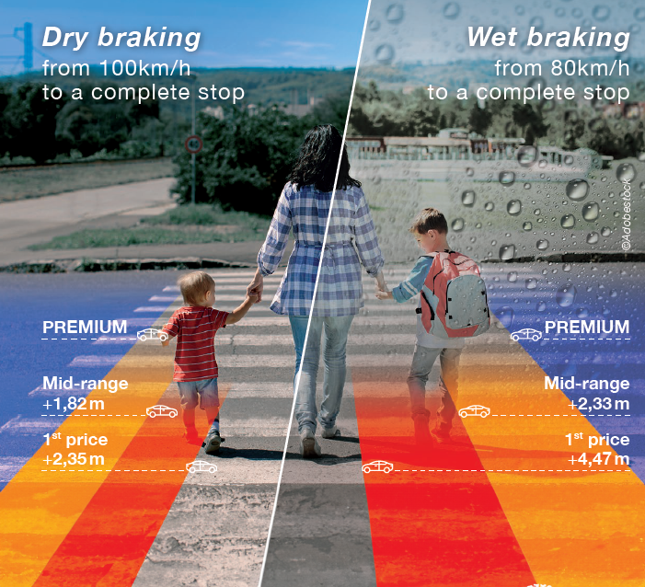
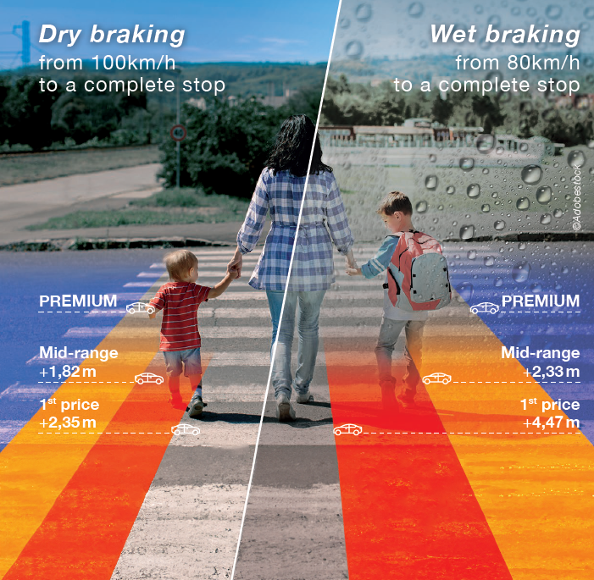
Distance can make a difference!
DISTANCE CAN MAKE A DIFFERENCE!
Don't risk your safety. With PREMIUM tyres, brake in time! With other tyres, you could need up to 2.35 meters more to stop on a dry road, and even 4.47 metres more on a wet road! Choose safety, opt for PREMIUM tyres!
Don’t hesitate to ask your Point S point of sale for more information!
Test requested by Point S from TÜV SÜD Product Service (independent laboratory, recognized throughout Europe): 225/40 R18 92Y. Brands tested: 5 PREMIUM vs. 3 second line vs. 3 budget. October 2023, VW Golf VIII GTD, report number 713311093-PR
#RoadSafety #PremiumTyres #ResponsibleDriving

Slide 31
Distance can make a difference!
Opt for peace of mind with PREMIUM tyres!
It's easy to forget about our tyres until something unexpected occurs. Many unpredictable things can happen on the road (a careless child, an animal crossing the road, etc.), and an accident can happen very quickly. That's why, although your tyres may look ordinary in everyday use, their maximum performance becomes crucial when the unexpected happens! To avoid this, PREMIUM tyres are for you. Their short braking distance will make all the difference.
Test requested by Point S from TÜV SÜD Product Service (independent laboratory, recognized throughout Europe): 225/40 R18 92Y. Brands tested: 5 PREMIUM vs. 3 second line vs. 3 budget. October 2023, VW Golf VIII GTD, report number 713311093-PR
Be prepared for the unexpected with PREMIUM tyres! #RoadSafety #PremiumTyres #PointStyres

Slide 32
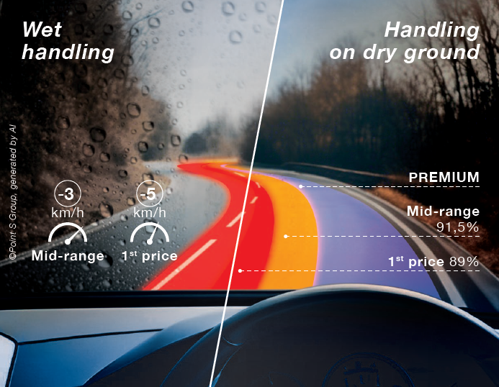
Think about your safety and that of your loved ones!
A pacified drive!
With PREMIUM tyres, you can enjoy a smooth and peaceful drive! With other tyres, you need to be extra vigilant: on wet roads, you'll have to drive 3 to 5 km/h slower to get the same grip as with PREMIUM tyres. Don't overlook your safety!
Don't hesitate to ask your Point S point of sale for more information!
Test requested by Point S from TÜV SÜD Product Service (independent laboratory, recognized throughout Europe): 225/40 R18 92Y. Brands tested: 5 PREMIUM vs. 3 second line vs. 3 budget. October 2023, VW Golf VIII GTD, report number 713311093-PR
#RoadSafety #PremiumTyres #PointStyres

Slide 33
Think about your safety and that of your loved ones!
Think about your safety and that of your loved ones!
Think about your safety and that of your loved ones! With PREMIUM tyres, you can count on exceptional road holding! Road holding refers to how the vehicle or tyres respond to the driver's commands such as steering, acceleration or braking. It is crucial for safety, vehicle stability and driving enjoyment. Stay safe on the road and avoid accidents with PREMIUM tyres.
Visit one of our Point S point of sale to find out how these tyres can improve your driving experience!
Test requested by Point S from TÜV SÜD Product Service (independent laboratory, recognized throughout Europe): 225/40 R18 92Y. Brands tested: 5 PREMIUM vs. 3 second line vs. 3 budget. October 2023, VW Golf VIII GTD, report number 713311093-PR
#RoadSafety #PremiumTyres #PointStyres

Slide 34
Don't compromise on your driving safety!
Don't compromise on your driving safety!
Choose PREMIUM tyres for superior quality, longer lifespan, and reduced braking distance. Don't let a budget tyre compromise your peace of mind on the road. Invest in safer driving with PREMIUM tyres.
#PremiumTyres #RoadSafety #PointStyres

Slide 35
Your safety is our first priority
Your safety is our first priority
At Point S, your safety is our top priority. That's why we're proud to offer you a selection of the best tyres on the market, carefully tested by the independent laboratory TÜV SÜD Product Service.
We know how crucial performing tyres are to safe and comfortable driving. That's why our team has carefully selected these tyres based on their performance and durability.
Contact your Point S point of sale us for more information on our selection of PREMIUM tyres.
Test requested by Point S from TÜV SÜD Product Service (independent laboratory, recognized throughout Europe): 225/40 R18 92Y. Brands tested: 5 PREMIUM vs. 3 second line vs. 3 budget. October 2023, VW Golf VIII GTD, report number 713311093-PR
#PremiumTyres #RoadSafety #PointStyres

Slide 36
Publication ideas for summer tyres

Slide 37
Ready to go on vacation?
Ready to go on vacation?
Not so fast! A few checks are necessary before getting behind the wheel. How do you check your car before you go on vacation?
1 - check and clean your windshield wipers
2 - check your headlights
3 - check your windscreen
4 - check the condition and the pressure of your tyres
5 - check your radiator
6 - check your vehicle liquid’s levels
7 - check the timing or driving belt
8 - check your exhaust pipe and rust
9 - check your brakes
10 - check your battery and for signs of corrosion
11 - check your emergency equipment

Slide 38
Summer Tyres
Summer Tyres
Summer tyres are designed to perform year-round in all weather conditions. They deliver optimal performance when the temperature is above 7°C.
Summer tyres come as standard on new vehicles and are the most common type in the market.
Visit your Point S center for a wide choice of summer tyres!

Slide 39
Summer Tyres
Is it possible to drive with winter tyres in the summer?
Winter tyres are designed to operate at low temperatures and have a lower heat dissipation capacity. But be careful, in summer, this increases the risk of over inflation but also the risk of the tyre bursting!

Slide 40
Publication ideas for winter tyres

Slide 41
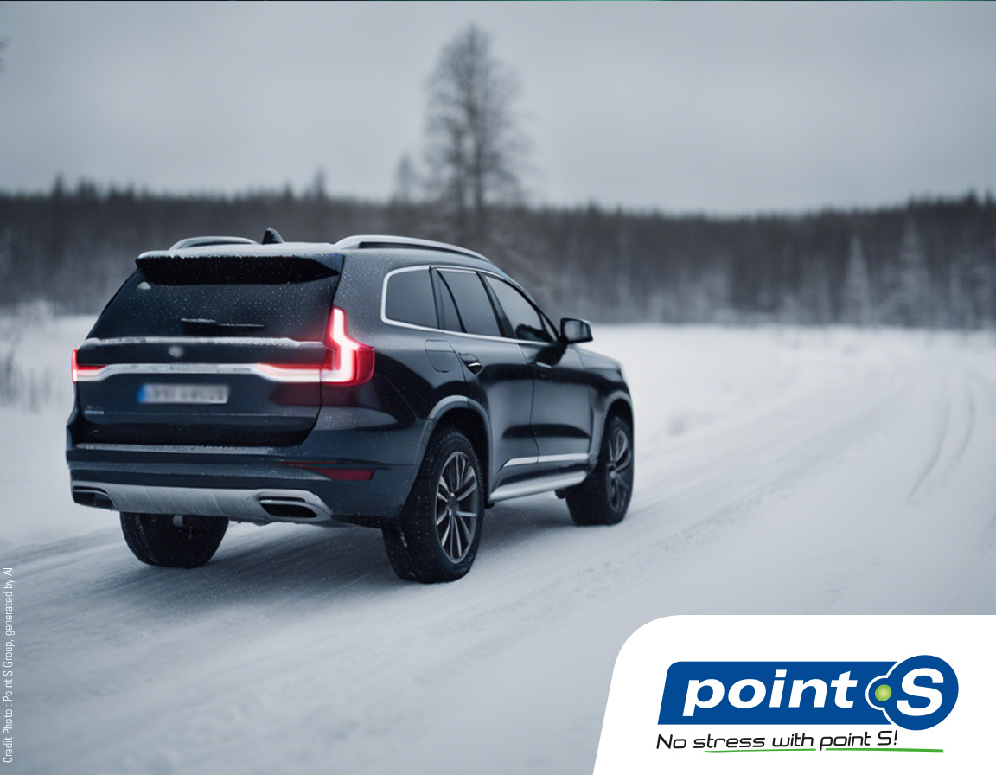
Winter tyres
The importance of winter tyres
Don't underestimate the importance of winter tyres when the temperature drops below 7 degrees!
Even without snow, winter tyres are essential because they provide maximum grip on slippery roads. They are more flexible in cold weather, reducing braking distances by half on snow. Don't let the cold catch you off guard while driving, make sure you have the right tyres for safe driving all winter long!
#WinterDriving #WinterTyres

Slide 42
Snow chains
Get ready for winter with snow chains!
Snow chains are the ultimate accessory for safely tackling snowy roads. They provide exceptional traction, preventing you from slipping and sliding. Thanks to them, you can maintain control of your vehicle, keep appropriate braking distances, and move confidently on snow-covered roads.
These chains are often designed with metal links, sometimes reinforced with steel for optimal traction. They attach to the driving wheels of your vehicle. If you frequently drive on snowy roads, they are a must-have. The maximum speed with snow chains is 50 km/h.

Slide 43
Snow chains
Point S guides you in choosing your snow chains
Different Types of Snow Chains:
Automatic Tension Snow Chains: Easy and quick to install, they adjust automatically when you start your vehicle. Ideal for those who frequently drive on snow, whether it's for accessing ski slopes or their daily commutes.
Manual Tension Snow Chains: These chains require a bit more practice, as you'll need to briefly stop to tighten and adjust them manually. Perfect for those who occasionally drive on snow.
Textile Snow Chains: Textile chains, also known as "composite," are made of extra-strong polyester links. They install like a cover on the tyre. The maximum speed with these chains is 40 km/h.
Spider Snow Chains: Quick to install and gentle on your rims, these chains come with studs that provide exceptional grip. To install them, you'll need an adapter. Ideal for those who frequently drive in extreme weather conditions.
#WinterDriving #SnowChains #RoadSafety

Slide 44
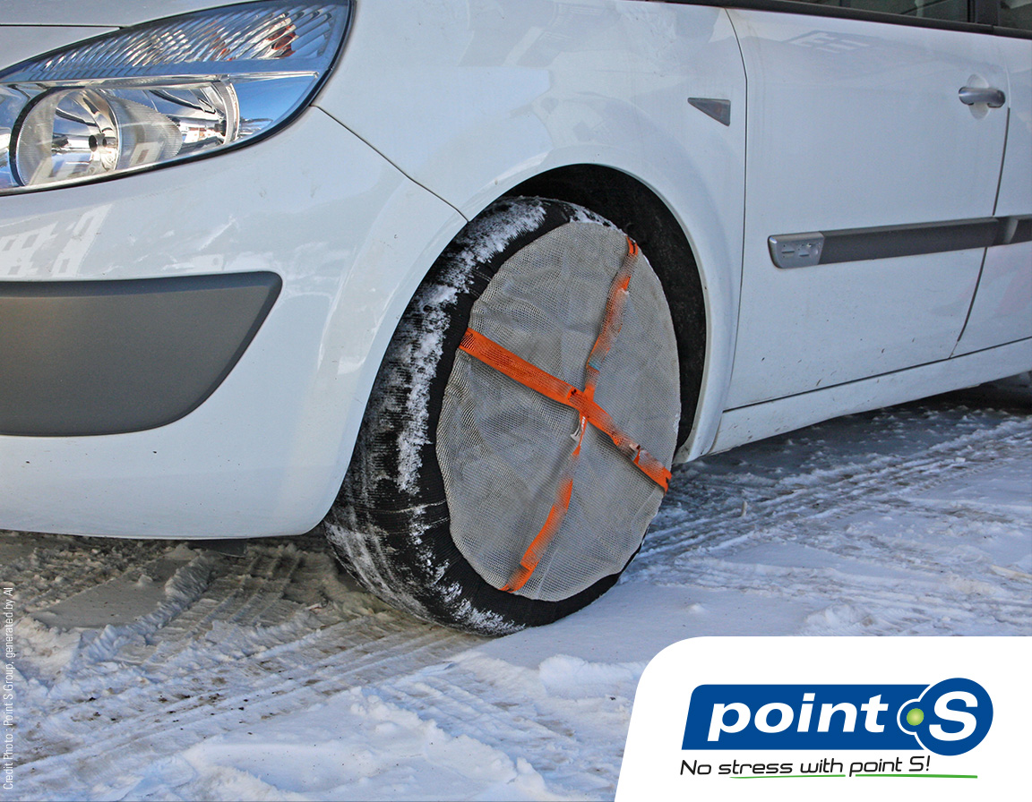
Snow socks
Snow socks
Snow socks are made of textile and look like covers that wrap around the tyre. If you're in an urban area where the roads are lightly covered with snow: opt for socks, which are lightweight, take up little space and are easy to use. Snow socks make less noise when you're driving. With snow socks you can't exceed 50km/h.

Slide 45
Snow socks
Do you need 2 or 4 snow socks?
Choosing between 2 or 4 snow socks depends on the type of vehicle you drive. You can drive safely with just 2 snow socks by placing them on the drive wheels, which are often the front wheels on front-wheel drive vehicles. For rear-wheel drive models, the drive wheels are at the rear. Consult your vehicle manual if you don't know where the drive wheels are. If you're looking for maximum grip, you can opt for 4 snow socks, especially for 4x4 vehicles with all-wheel drive.

Slide 46
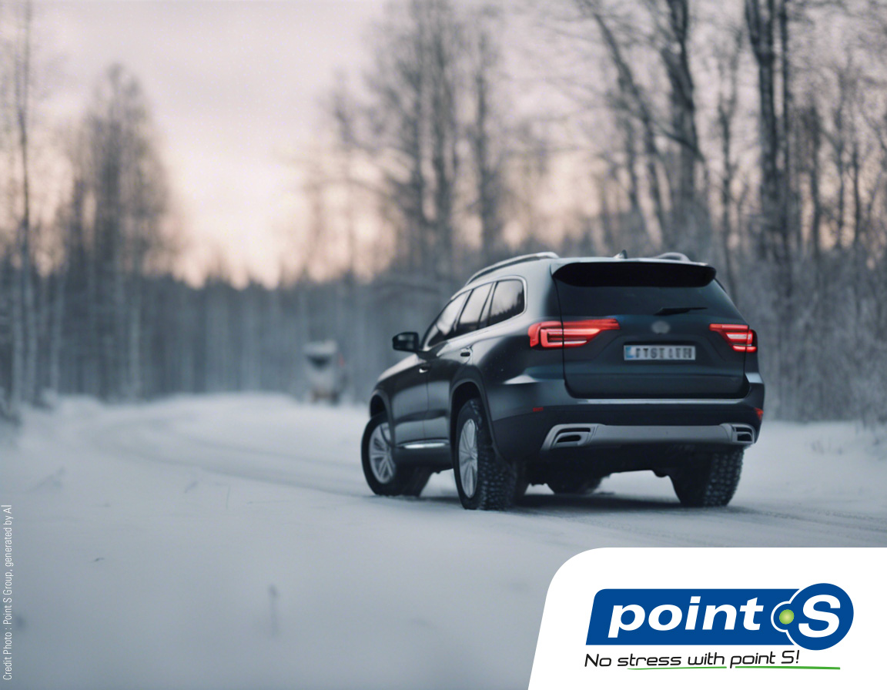
10 tips
10 tips to best choose your winter tyres
Choosing the right winter tyres can be difficult for any driver who wants to drive safely. The Point S experts offer 10 tips to guide your decision
1- Know the size of your tyres
2- Know what types of roads you drive on
3 – Look at condition the tyres
4 – Ask the right questions
5 – Choose between snow and ice tyres
6 – Learn about handling and braking
7 – Compare EU tyre labelling
8 – Insist on getting several offers
9 – Do not mix tyres ranges
10 – Respect your budget!

Slide 47
Publication ideas for
4 seasons tyres

Slide 48
Winter and All-Season Tyres
The key difference between winter tyres and all-season tyres lies in their design. Winter tyres feature deeper grooves and more pronounced tread patterns compared to all-season (and summer) tyres. This feature not only facilitates efficient water drainage but also ensures optimal traction on ice and light, melting snow. An essential choice for safe driving during the cold season.
#CarTips #WinterTyres #AllSeasonTyres

Slide 49
Tyres for 4 Seasons!
When it comes to choosing the right tyres, it all depends on the weather and your driving habits:
- If the climate is mild all year round, tyres for all seasons are practical.
- Low annual mileage? Opt for all-season tyres.
At Point S, we recommend tyres tailored to each season. The growing trend for tyres for all seasons is in response to changing climate conditions.
Attention it's ideal for city-driver, but it's not a substitute for winter and summer tyres !
Make the smart choice for safe driving all year round
#TyresForAllSeasons #SafeDriving

Slide 50
Publication for
Point S Tyres

Slide 51
Point S Tyres (range)
For safe, stress-free driving at an attractive price: don't wait any longer and choose Point S Tyres.
Made in Europe, Point S Tyres guarantee quality and safety on the roads, in all weather conditions and seasons, thanks to its wide range of tyres: Point S Summer, Point S Winter and Point S 4 Seasons.
Point S Tyres are the perfect combination of good value for money and guaranteed safety.
To find out more about the Point S Tyres range, visit our website "xxxxxxx" or your nearest Point S centre.

Slide 52
Point S Tyres (range)
Don’t compromise between price and safety.
Point S Tyres are made in Europe. They guarantee quality and safety on the road in all weathers thanks to its wide range of tyres: Point S Summer, Point S Winter. and Point S 4 Seasons.
Point S Tyres are the perfect combination of good value for money and guaranteed safety.
For more information on the Point S range, visit our website or your nearest Point S centre

Slide 53
Point S Summer
Point S Summer
For safe, stress-free driving at an attractive price: Don't wait any longer and choose Point S Summer and Summer Van.
Made in Europe, our summer tyres guarantee quality and safety on dry roads thanks to their braking performance and longevity.
It's the perfect combination of good value for money and guaranteed safety.
To find out more about our summer range, visit our website "XXXXXXX" or your nearest Point S centre!
No stress with Point S!

Slide 54
Point S Summer
Don’t compromise between price and safety.
Point S Summer and Point S Summer Van tyres are made in Europe. They guarantee quality and safety on dry roads thanks to their braking performance and longevity.
Point S Summer and Point S Summer Van tyres are the perfect combination of good value for money and guaranteed safety.
For more information on the Point S Summer and Point S Summer Van range, visit their website or your nearest Point S center.
The criteria refer to tests commissioned by Point S from TÜV SÜD Product Service (an independent laboratory recognised throughout Europe), tested size 205/55R16 91V. July/August 2021, report no. 713221720-S6.

Slide 55
Point S Winter
Point S Winter
For safe, stress-free driving at an attractive price:
Don't wait any longer and choose Point S Winter and Winterstar4 Van.
Made in Europe, these winter tyres guarantee quality and safety on snow-covered roads thanks to their good roadholding.
It's the perfect combination of good value for money and guaranteed safety.
To find out more about our winter range, visit our website "XXXXXXX" or your nearest Point S centre!
No stress with Point S!

Slide 56
Point S Winter
Don’t compromise between price and safety.
Point S Winter and Winterstar 4 Van tyres are made in Europe. They guarantee quality and safety on snow-covered roads thanks to their good road holding.
Point S Winter tyres are the perfect combination of good value for money and guaranteed safety.
For more information on the Point S Winter and Winterstar 4 range, visit their website or your nearest Point S centre.
The criteria refer to tests commissioned by Point S from TÜV SÜD Product Service (an independent laboratory recognised throughout Europe), size tested 205/55R16 91H. May/July 2022, report no. 713258351-WR2.

Slide 57
Point S 4 Seasons
Point S 4 Seasons
For safe, stress-free driving at an attractive price: Don't wait any longer and choose Point S 4 Seasons and Point S 4 Seasons Van.
Manufactured in Europe, 4-season tyres ensure quality and safety on wet and dry roads thanks to their good roadholding.
It's the perfect combination of good value for money and guaranteed safety.
To find out more about our 4-season range, visit our website "XXXXXXX" or your nearest Point S centre !
No stress with Point S!

Slide 58
Point S 4 Seasons
Don’t compromise between price and safety.
Point S 4 Seasons and Point S 4 Seasons Van tyres are made in Europe. They guarantee quality and safety on wet and dry roads thanks to their good road holding.
Point S 4 Seasons tyres are the perfect combination of good value for money and guaranteed safety.
For more information on the Point S 4 Seasons and Point S 4 Seasons Van range, visit their website or your nearest Point S centre .

Slide 59
Point S : Private Label
Wiper blades
Did you know that you can easily check if your wiper blades are worn?
Run a wash cycle on the front and rear…
For more information, visit your Point S point of sale! What's more, by choosing Point S wiper blades, you don't have to compromise between quality and price!

Slide 60
Point S : Private Label
Point S bulbs
Seeing and being seen is very important when driving at night. Have you thought about checking the condition of your lights?
Visit one of our Point S point of sale! Our teams will be happy to check this for your safety! We have a wide range of bulbs for your vehicle. With Point S bulbs there is no compromise between safety and price!

Slide 61
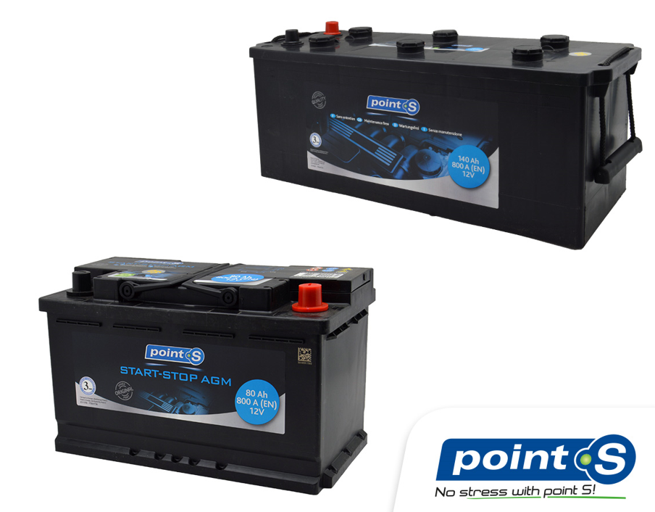
Point S : Private Label
Car battery
Before buying a new car battery for a diesel or petrol vehicle, make sure it is compatible with your car.
Check not only the size of the battery to be replaced, but also its voltage and capacity. You can find this information in your car's service booklet or on the label of your current battery.
Discover a complete range of Point S battery in one of our centres, where our team will be delighted to guide you in choosing the battery that best suits your vehicle.

